Slide 1
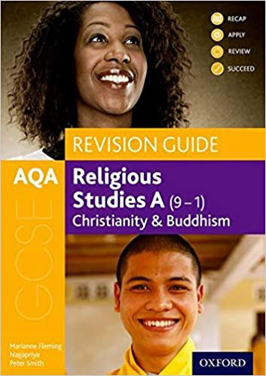
Christian Practices
Christian Beliefs and Teachings
Belief, Teachings and Practices are covered in each religion during Year 10
AQA A
Buddhist Beliefs and Teachings
GCSE Religious Studies
Buddhist Practices
Theme B - Religion and Life
We take the students on two visits to help them understand the practices elements of the course
Religion and Life is covered in year 11 – Topic include – Scientific truth vs Religious truth, The Environment, Animal Rights, The value of Human Life, Euthanasia, Abortion, Death and the Afterlife

Slide 2
3.1.1.1 Christian Beliefs and teachings
Key beliefs
The nature of God:
•• God as omnipotent, loving and just, and the problem of evil and suffering
•• the oneness of God and the Trinity: Father, Son and Holy Spirit.
Different Christian beliefs about creation including the role of Word and Spirit (John 1:1–3 and Genesis 1:1–3).
Different Christian beliefs about the afterlife and their importance, including: resurrection and life after death; judgement, heaven and hell.
Jesus Christ and salvation
Beliefs and teachings about:
•• the incarnation and Jesus as the Son of God
•• the crucifixion, resurrection and ascension
•• sin, including original sin
•• the means of salvation, including law, grace and Spirit
•• the role of Christ in salvation including the idea of atonement.

Slide 3
3.1.2.2 Christian Practices
Worship and festivals
Different forms of worship and their significance:
•• liturgical, non-liturgical and informal, including the use of the Bible
•• private worship.
Prayer and its significance, including the Lord’s Prayer, set prayers and informal prayer.
The role and meaning of the sacraments: the meaning of sacrament; the sacrament of baptism and its significance for Christians; infant and believers’ baptism; different beliefs about infant baptism; the sacrament of Eucharist (Holy Communion) and its significance for Christians, including different ways in which it is celebrated and different interpretations of its meaning.
The role and importance of pilgrimage and celebrations including:
•• two contrasting examples of Christian pilgrimage: Lourdes and Iona
•• the celebrations of Christmas and Easter, including their importance for Christians in Great Britain today.
The role of the church in the local and worldwide community
The role of the Church in the local community, including food banks and street pastors.
The place of mission, evangelism and Church growth.
The importance of the worldwide Church including: working for reconciliation; how Christian churches respond to persecution; the work of one of the following: Catholic Agency For Overseas Development (CAFOD), Christian Aid, Tearfund.

Slide 4
3.1.1.1 Buddhist Beliefs and teachings
The Dhamma (Dharma)
•• The concept of Dhamma (Dharma).
•• The concept of dependent arising (paticcasamupada).
•• The Three Marks of Existence: impermanence (anicca); no fixed self (anatta); unsatisfactoriness of life, suffering (dukkha).
•• The human personality, in the Theravada and Mahayana traditions: Theravada: the Five Aggregates (skandhas) of form, sensation, perception, mental formations, consciousness; Mahayana: sunyata, the possibility of attaining Buddhahood and Buddha-nature.
•• Human destiny: Different ideals in Theravada and Mahayana traditions: Arhat (a ‘perfected person’) and Bodhisattva ideals; Buddhahood and the Pure Land.
3.1.1.2 The Buddha and the Four Noble Truths
•• The Buddha’s life and its significance: the birth of the Buddha and his life of luxury; the Four Sights: illness, old age, death, holy man (Jataka 075); the Buddha’s ascetic life; the Buddha’s Enlightenment.
•• The Four Noble Truths:
1 suffering (dukkha) including different types of suffering
2 the causes of suffering (samudaya); the Three Poisons, ignorance, greed and hate
3 the end of craving (tanha), interpretations of nibbana (nirvana) and Enlightenment
4 the Eightfold Path (magga) to nibbana/nirvana; the path as the Threefold Way: ethics (sila), meditation (samadhi) and wisdom (panna). Dhammapada 190 –191.

Slide 5
3.1.1.3 Buddhist Practices - Worship and festivals
•• The nature, use and importance of Buddhist places of worship including temples, shrines, monasteries (viharas), halls for meditation or learning (gompas) and their key features including Buddha rupa, artefacts and offerings.
•• Puja, the significance and role of puja/devotional ritual in the home and in the temple, including chanting, both as a devotional practice and as an aid to mental concentration, mantra recitation, use of malas.
•• Meditation, the different aims, significance and methods of meditation: Samatha (concentration and tranquillity) including mindfulness of breathing; Vipassana (insight) including zazen; the visualisation of Buddhas and Bodhisattvas.
•• The practice and significance of different ceremonies and rituals associated with death and mourning in Theravada communities and in Japan and Tibet.
•• Festivals and retreats and their importance to Buddhists in Great Britain today, including the celebrations, origins and significance of: Wesak; Parinirvana Day.
Buddhist ethics
•• Ethical teaching: kamma (karma) and rebirth; compassion (karuna); loving kindness (metta).
•• The five moral precepts: do not take life; do not take what is not given; do not misuse the senses; do not speak falsehoods; do not take intoxicants that cloud the mind.
•• The six perfections in the Mahayanan tradition: generosity; morality; patience; energy; meditation; wisdom, including how the individual develops these perfections within themselves.

Slide 6
Final Theme to add to the previous 3 completed in year 9

