Slide 1
GCSE Electronics
Written Examinations
Components 1 and 2

Slide 2
GCSE Electronics
Assessment Objectives
 | Objective | Weighting
AO1 | Demonstrate knowledge and understanding of the ideas, techniques and procedures of electronics | 35%
AO2 | Apply knowledge and understanding of the ideas, techniques and procedures of electronics | 35%
AO3 | Analyse problems and design, build, test and evaluate electronic systems to address identified needs | 30%

Slide 3
GCSE Electronics
Written examinations
The questions will include:
Demonstration of knowledge and understanding of the ideas, techniques and procedures of electronics
Appling knowledge and understanding of the ideas, techniques and procedures of electronics
Analysing problems and designs, and evaluating electronic systems to address identified needs
A minimum of 20% of marks are for mathematical skills
One quality of extended response (QER) questions per paper

Slide 4
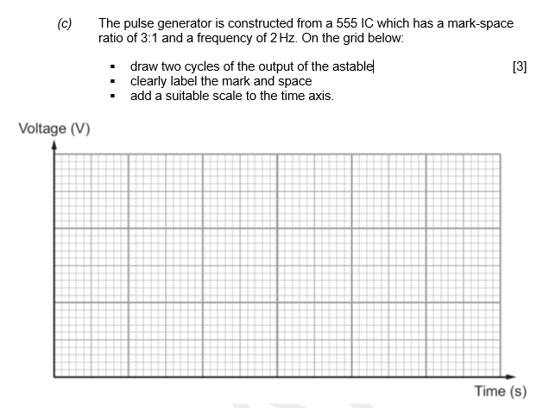
GCSE Electronics
Drawing graphs from given data
AO1
Notes:
Component 1 Question 3 (c)

Slide 5
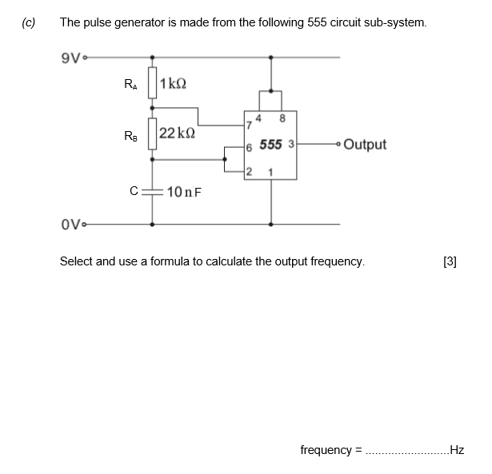
GCSE Electronics
Marks for workings out
AO1 & 2
Notes:
Component 2 Question 3 (c)

Slide 6
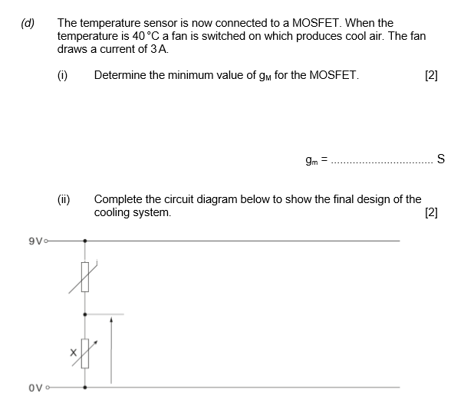
GCSE Electronics
AO2
Design
AO3
Notes:
Component 1 Question 8 (d)

Slide 7
GCSE Electronics
AO3
QER
Evaluation
Notes:
Component 2 Question 10

